Slide 1
MarineGEO BiteMap
Generating a global map of predation pressure

Slide 2
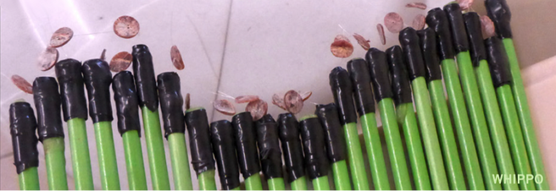
Basic Method: SquidPops

Slide 3
2016/2017: Focus on seagrass habitats
compare predation intensity in vegetated and unvegetated habitats
combine SquidPops with surveys of fish community
seining (most sites)
GoPro (some sites)

Slide 4
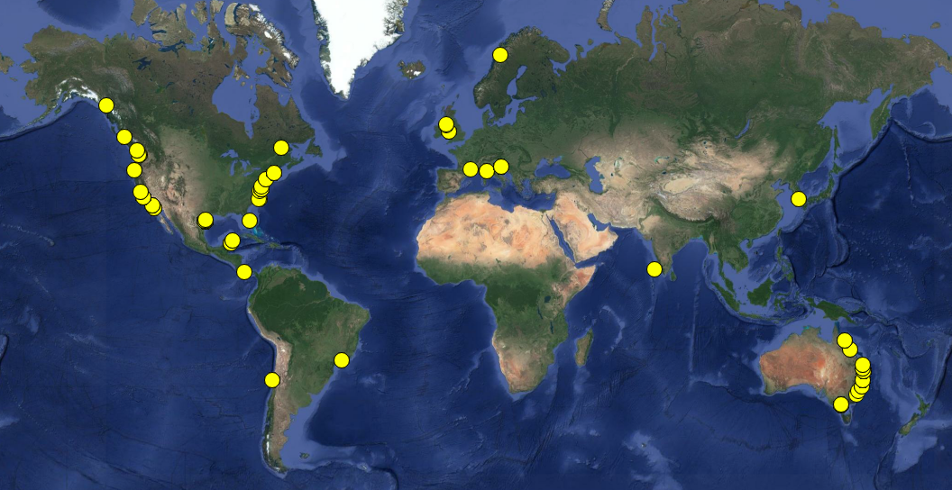
Global Extent – 105 degrees of latitude

Slide 5
Predation patterns across latitude
prop24: the proportion of squid lost after 24 hours

Slide 6
Predation patterns with temperature
Using annual mean SST from satellite data, we see a dip at high temps/low latitudes

Slide 7
Predation patterns with temperature
Using in situ temperature during the study periods, quadratic effect goes away

Slide 8
Fish biomass greater in seagrass

Slide 9
Fish diversity higher in seagrass

Slide 10
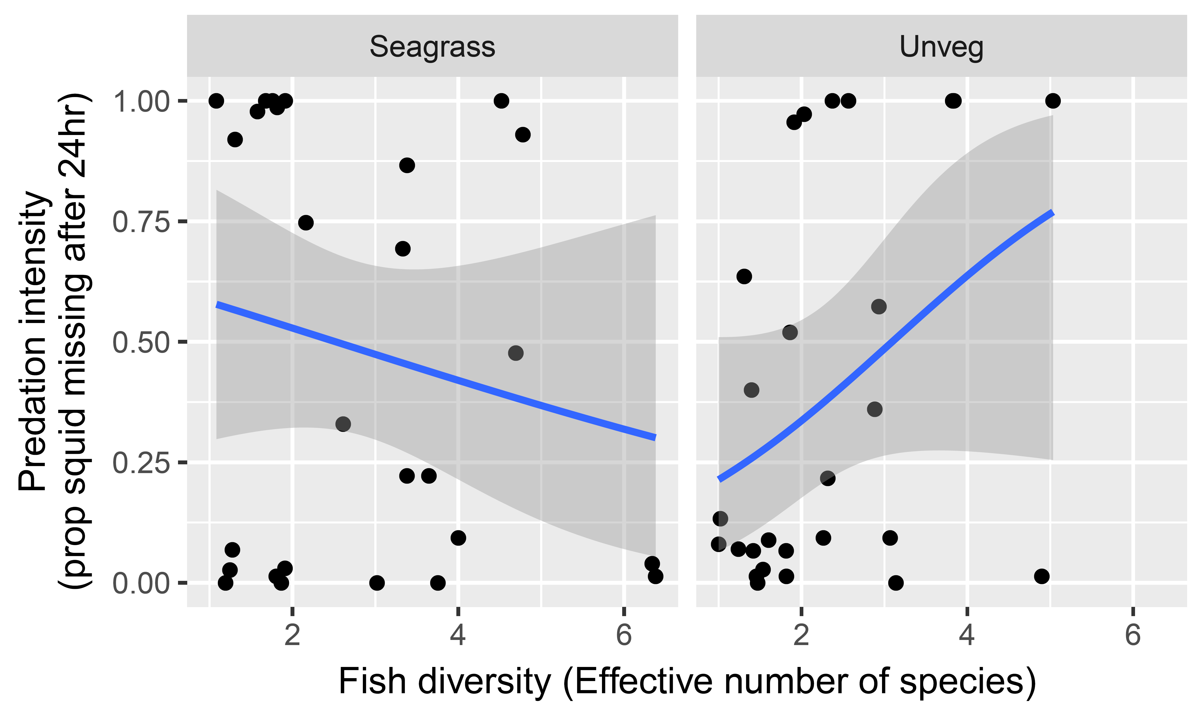
Fish biomass unrelated to predation, weird results for fish diversity

